Slide 1
Final Project
Esteban Guerrero Bravo
Data Scientist Program - EANT
December 20, 2018

Slide 2
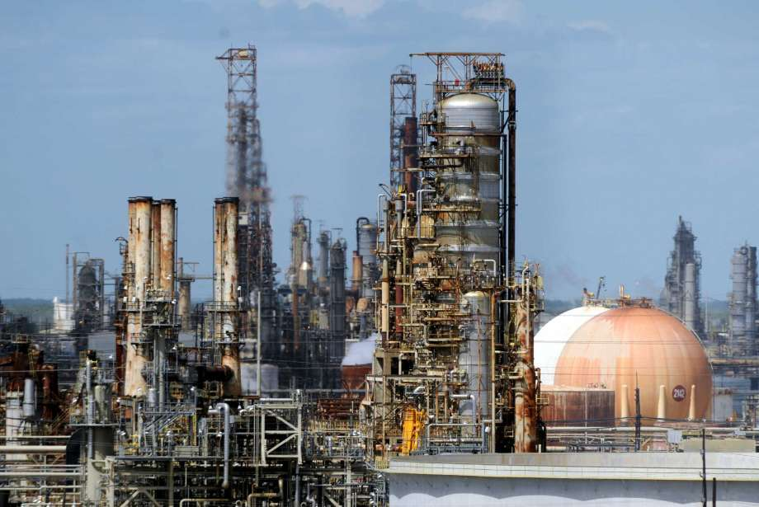

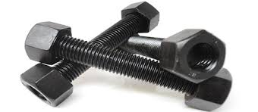
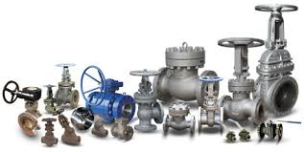


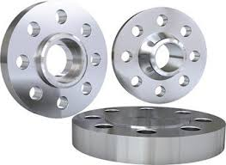
Project Description
Amazon-like application to be used by requisitioners located in various ExxonMobil sites around the world
Alberta, Canada
Gulf Coast
Pilot launch in two sites

Slide 3
Areas of Implementation
Supplier Selection ML Modeling
Procurement Metrics
Text Mining for Free-Form Purchases
(future development)
RStudio
Data Exploration
Clustering
Logistic Regression
Decision Trees
Python
SQL DB Connection
Data Processing
Python
Extraction of material codes from free-form text purchase orders

Slide 4

Workflow Stages
Supplier Selection Modeling
Use Cases Definition
Data Extraction
Data Transfor-mation
Rest of world supplier selection based on pilot sites
SAP Systems
Pilot Site 1, Pilot Site 2, Destination Site 1, Destination Site 2
Initial: purch. history 22 months, 75 variables
Final: pivot per supplier, 13 variables
ML Modeling
Data Explora- tion
Clustering (kmedias, PAM)
Logistic Regression and Decision Tree
Plotly
Variables plotting
Outlier detection (interquartiles)
Correlation Matrix chart
Testing and Validation
Training
Sustain-
ment in Prod
Data Pilot Site 1 and
Pilot Site 2
Destination Site 1 and
Destination Site 2
Future development

Slide 5
ML Modeling Process
Supplier Selection Modeling
Combine Pilot Sites Data
Clustering: Escalar + Elbow +WCV
Balancear Testing / Validación y dividir dataset
Modelar en training y predecir en validación
Calcular matriz de confusión para varios umbrales y determinar el optimo (sensibilidad vs especificidad)
Calcular métricas del modelo con el umbral seleccionado
Predecir en Testing (Sarnia y Strathcona)
Training = BMRF
Validación = Kearl
Con outliers
RL1
RL2
Árbol
Enfoque 1
+
Training = 70% BMRF + 70% Kearl
Validación = 30% Kearl + 30% Kearl
Con outliers
RL1
RL2
Árbol
Enfoque 2
+
Predicción
Training = 70% BMRF + 70% Kearl
Validación = 30% Kearl + 30% Kearl
Sin outliers
RL1
RL2
Árbol
Enfoque 3
+

Slide 6
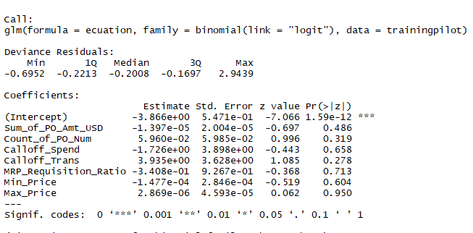
ML Models Evaluation
Supplier Selection Modeling
 |  | Scenario 1 |  |  | Scenario 2 |  |  | Scenario 3
 |  | Testing PS1 + Validation PS2 |  |  | PS1 + PS2, 70% Testing, 30% Validation |  |  | PS1 + PS2, 70% Testing, 30% Validation
 |  | With outliers |  |  | With outliers |  |  | No outliers
 |  | LR1 | LR2 | Tree | LR1 | LR2 | Tree | LR1*
RMSE | Root-mean-square deviation | 37.77% | 36.49% | 33.31% | 28.64% | 34.62% | 20.34% | 42.74%
Accuracy | Percentage of cases correctly classified | 85.74% | 86.69% | 88.91% | 91.80% | 88.01% | 92.74% | 81.74%
Precision | Percentage of cases considered as positive that actually are | 24.78% | 26.17% | 30.93% | 48.72% | 38.18% | 53.57% | 5.26%
Sensibility | Percentage of positive cases found | 84.85% | 84.85% | 90.91% | 76.00% | 84.00% | 60.00% | 33.33%
Specificity | Percentage of negative cases found | 85.79% | 86.79% | 88.80% | 93.15% | 88.36% | 95.55% | 83.10%
Probability Threshold |  | 13.59% | 9.80% | 55.20% | 8.40% | 5.70% | 3.70% | 2.80%
* Without outliers, no variables with significant weight in LR
- PS1: Pilot Site 1
- PS2: Pilot Site 2

Slide 7



BuySmart Performance Measurement
Procurement Metrics
Connection with SQL Server and site codes selection
Variables adjustment
Joins with master tables
Calculation of aggregated variables
CSV file generation per system and consolidation
Calculation of Benefits Metrics
Performance Measurement
Dashboard

Slide 8


Purchases Under Free-Form Text
Text Mining
Purchases under contract,
negotiated prices
Purchases under free-form text,
no contract, high risk of overprices due to low quality of the BuySmart catalog
Purchase order monitoring algorithm to improve the BuySmart catalog
Connection with SQL server and supplier selection
Identify new materials
Comparison with the BuySmart catalog
Notify Agreement Managers regarding new materials to be added
Notify requisitioners regarding materials purchased via free-text that are actually present in the BuySmart catalog

